Slide 1
Introduction to Java 8
Juan Manuel Gimeno Illa
jmgimeno@diei.udl.cat

Slide 2
Evolution of Java
Java 1.0: Initial version
Java 1.1: Inner classes, JDBC, …
Java 1.2: Swing, Collections, ...
Java 5: Generics, Annotations, Autoboxing, ...
Java 7: Diamond operator, try-with-resources, ...
Java 8: Lambda expressions, Streams, Default methods, ...

Slide 3
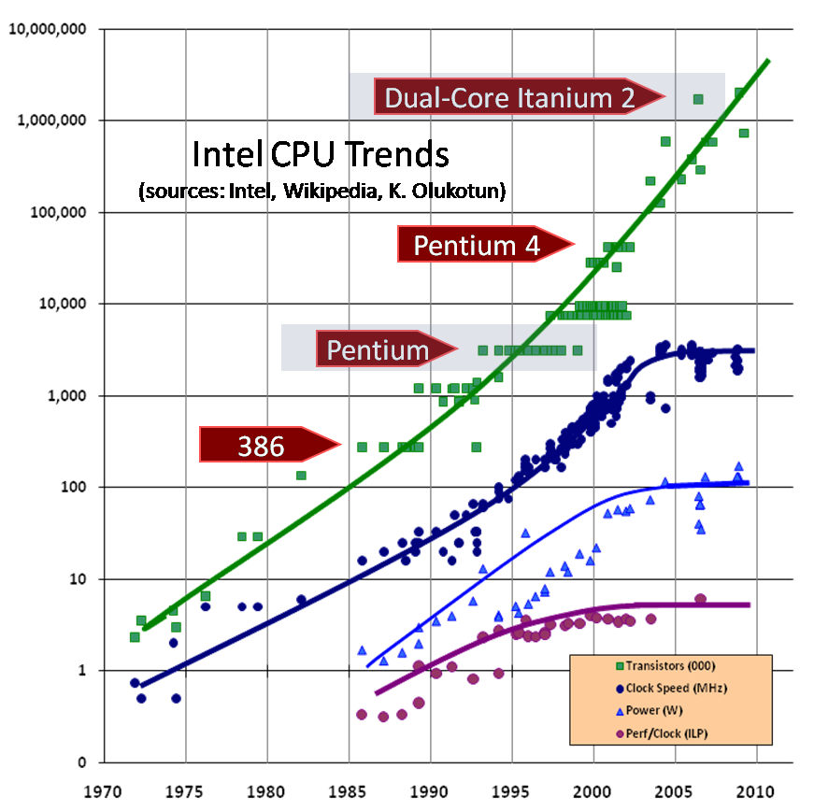
The Free Lunch Is Over, by Herb Sutter (2010)

Slide 4
Concurrency in Java
Java 1.0: java.lang.Thread, synchronized blocks
Java 5.0/6.0: java.util.concurrent (JSR166)
Java 7.0: Fork/Join Framework (JSR166)
Java 8.0: Parallel Streams, Completable Futures

Slide 5
Lambdas

Slide 6
Behaviour parameterization
It is the ability to take multiple behaviours as parameters and use them to accomplish different comportments
It lets you make your code more adaptive to changing requirements
Passing code is a way to give behaviours as arguments to a method
Using classes is very verbose
Even anonymous inner classes are verbose !!!

Slide 7
Behaviour parameterization
public class Apple { private int weight = 0; private String color = ""; public Apple(int weight, String color){ this.weight = weight; this.color = color; } public Integer getWeight() { return weight; }
public void setWeight(Integer weight) { this.weight = weight;} public String getColor() { return color;} public void setColor(String color) { this.color = color;}
public String toString() { return "Apple{" + "color='" + color + '\'' + ", weight=" + weight + '}'; }
}

Slide 8
Behaviour parameterization
public static List<Apple> filterGreenApples(List<Apple> inventory){ List<Apple> result = new ArrayList<>(); for(Apple apple: inventory){ if("green".equals(apple.getColor())){ result.add(apple); } } return result; }

Slide 9
Behaviour parameterization
public static List<Apple> filterApplesByColor(List<Apple> inventory, String color){ List<Apple> result = new ArrayList<>(); for(Apple apple: inventory){ if(apple.getColor().equals(color)){ result.add(apple); } } return result; }

Slide 10
Behaviour parameterization
public static List<Apple> filterApplesByWeight(List<Apple> inventory, int weight){ List<Apple> result = new ArrayList<>(); for(Apple apple: inventory){ if(apple.getWeight() > weight){ result.add(apple); } } return result; }

Slide 11
Behaviour parameterization
public interface ApplePredicate{ boolean test(Apple a); }
public static List<Apple> filter(List<Apple> inventory, ApplePredicate p){ List<Apple> result = new ArrayList<>(); for(Apple apple : inventory){ if(p.test(apple)){ result.add(apple); } } return result; }

Slide 12
Behaviour parameterization
public class AppleWeightPredicate implements ApplePredicate{ public boolean test(Apple apple){ return apple.getWeight() > 150; } }
public class AppleColorPredicate implements ApplePredicate{ public boolean test(Apple apple){ return "green".equals(apple.getColor()); } }

Slide 13
Behaviour parameterization
List<Apple> greenApples = filter(inventory, new ApplePredicate() { @Override public boolean test(Apple a) { return "green".equals(a.getColor()); } });
This is the only information that “matters”.
The rest of the code is “boilerplate”
List<Apple> greenApples = filter(inventory, a -> "green".equals(a.getColor()));
We provide only the essential information

Slide 14
Lambda expressions
“A lambda expression can be understood as a concise representation of an anonymous function that can be passed around: it doesn’t have a name, but it has a list of parameters, a body, a return type and also possibly a list of exceptions that can be thrown”

Slide 15
Lambda expressions
arrow
(Apple a1, Apple a2) -> a1.getWeight().compareTo(a2.getWeight())
parameters
Body (if one expression, it is the return value
(parameters) -> expression
(parameters) -> { statements; }

Slide 16
Functional interface
A functional interface is an interface that specifies exactly one abstract method
public interface Comparator<T> { int compareTo(T o1, T o2); } public interface Runnable { void run(); } public interface ActionListener extends EventListener { void actionPerformed(ActionEvent event); } public interface Callable<V> { V call(); }

Slide 17
Functional interface
“Lambda expressions let you provide the implementation of the abstract method of a functional interface directly inline and treat the whole expression as an instance of a functional interface (more technically speaking, an instance of a concrete implementation of the functional interface)”
Runnable r1 = () -> System.out.println("Hello World !!");

Slide 18
Functional descriptor
The signature of the abstract method of the functional interface describes the signature of the lambda expression
We call this abstract method a functional descriptor
E.g. the Runnable interface can be viewed as a signature of a function which accepts nothing (no parameters) and returns nothing (void)

Slide 19
Common functional interfaces
Functional Interface | Functional Descriptor
Predicate<T> | T -> boolean
Consumer<T> | T -> void
Function<T, R> | T -> R
Supplier<T> | () -> T
UnaryOperation<T> | T -> T
BinaryOperation<T> | (T, T) -> T
BiPredicate<L, R> | (L, R) -> boolean
BiConsumer<T, U> | (T, U) -> void
BiFunction<T, U, R> | (T, U) -> R

Slide 20
@FunctionalInterface
If you explore the new Java API you’ll notice that functional interfaces are annotated with @FunctionalInterface
Used to indicate the interface is intended to be a functional interface
So the compiler will return a meaningful error if it is not
This annotation is not mandatory but it is good practice (such as @Override)

Slide 21
Primitive specializations
Every type in Java is either
A primitive type (int, double, …)
A reference type (Integer, Double, …)
Since Java 5 boxing/unboxing can be done implicitly
Java 8 brings a specialized version of the functional interfaces on order to avoid auto-boxing operations when the inputs or outputs are primitives
E.g. IntPredicate avoids the boxing that would be done by using Predicate<Integer>

Slide 22
What about exceptions?
None of the functional interfaces presented before allow for a checked exception to be thrown
You have to options:
Define your own functional interface
Wrap the lambda body with a try/catch block

Slide 23
Method references
A shorthand for lambdas calling only a specific method
Lambda | Method reference
(Apple a) -> a.getWeight() | Apple::getWeight
() -> Thread.currentThread().dumpStack() | Thread.currentThread()::dumpStack()
(str, i) -> str.substring(i) | String::substring
(String s) -> System.out.println(s) | System.out::println

Slide 24
Constructor references
A shorthand for lambdas creating a new instance in the body
Lambda | Functional interface | Constructor reference
() -> new Apple() | Supplier<Apple> | Apple::new
(weight) -> new Apple(weight); | Function<Integer, Apple> | Apple::new
(str, i) -> new Apple(str, i); | BiFunction<String, Integer, Apple> | Apple::new

Slide 25
streams

Slide 26
Streams
Collections is the most used Java API
But its operations are “low level” (e.g. they lack the expressiveness of database-like operations)
Difficult to leverage multicore
Streams are an update to the Java API that
Let’s you manipulate data in a declarative way
And that can be processed in parallel transparently

Slide 27
Before (Java 7)
public static List<String> getLowCaloricDishesNamesInJava7(List<Dish> dishes){ List<Dish> lowCaloricDishes = new ArrayList<>(); for(Dish d: dishes){ if(d.getCalories() < 400){ lowCaloricDishes.add(d); } } Collections.sort(lowCaloricDishes, new Comparator<Dish>() { public int compare(Dish d1, Dish d2){ return Integer.compare(d1.getCalories(), d2.getCalories()); } });
List<String> lowCaloricDishesName = new ArrayList<>(); for(Dish d: lowCaloricDishes){ lowCaloricDishesName.add(d.getName()); } return lowCaloricDishesName; }

Slide 28
Now (Java 8)
import static java.util.Comparator.comparing; import static java.util.stream.Collectors.toList;
public static List<String> getLowCaloricDishesNamesInJava8(List<Dish> dishes){ return dishes.stream() .filter(d -> d.getCalories() < 400) .sorted(comparing(Dish::getCalories)) .map(Dish::getName) .collect(toList()); }
lambda
lambda
lambda
dishes
filter
sorted
map
collect

Slide 29
What is a stream?
A sequence of elements from a source that supports data processing operations
Sequence of elements
Collections are about data
Streams are about computations
Source
Streams consume data from a providing source
Data processing operations
Database-like & Functional programming
Pipelining & Internal iteration

Slide 30
Visualizing stream processing
Menu stream
Stream<Dish>
filter(….)
Stream<Dish>
map(Dish::getName)
Stream<String>
limit(3)
Stream<String>
collect(toList())
List<String>

Slide 31
Streams from files
We can create a Stream from the contents of a file
Files.lines is the Stream<String> of the lines of the file
long uniqueWords = Files.lines(Paths.get("lambdasinaction/chap5/data.txt"),
Charset.defaultCharset()) .flatMap(line -> Arrays.stream(line.split(" "))) .distinct() .count();

Slide 32
Better separation of concerns
List<String> errors = new ArrayList<>(); int errorCount = 0; File file = new File(fileName); String line = file.readLine(); while (errorCount < 40 && line != null) { if (line.startsWith("ERROR")) { errors.add(line); errorCount++;
} line = file.readLine(); }
List<String> errors =
Files.lines(Paths.get(fileName))
.filter(l->l.startsWith("ERROR")
.limit(40)
.collect(toList());

Slide 33
Grouping transactions by currency
private static void groupImperatively() { Map<Currency, List<Transaction>> transactionsByCurrencies = new HashMap<>(); for (Transaction transaction : transactions) { Currency currency = transaction.getCurrency(); List<Transaction> transactionsForCurrency =
transactionsByCurrencies.get(currency); if (transactionsForCurrency == null) { transactionsForCurrency = new ArrayList<>(); transactionsByCurrencies.put(currency, transactionsForCurrency); } transactionsForCurrency.add(transaction); } System.out.println(transactionsByCurrencies); }

Slide 34
Grouping transactions by currency
private static void groupFunctionally() { Map<Currency, List<Transaction>> transactionsByCurrencies =
transactions.stream()
.collect(groupingBy(Transaction::getCurrency)); System.out.println(transactionsByCurrencies); }

Slide 35
Parallel streams
You can turn a collection into a parallel stream by invoking the method parallelStream on it
A parallel stream is a stream that splits its elements into multiple chunks, processing each chunk with a separate thread
Uses Fork/Join framework
SplitIterator
But
Parallelization is not free
Not all collections or operations perform equally
Side effects are bad !!!!

Slide 36
Parallel streams
public static long parallelSum(long n) { return Stream.iterate(1L, i -> i + 1)
.limit(n)
.parallel()
.reduce(0L, Long::sum); }
Output
Iterate
Function
Input
public static long parallelRangedSum(long n) { return LongStream.rangeClosed(1, n)
.parallel()
.reduce(0L, Long::sum); }

Slide 37
Parallel streams
Source | Decomposability
ArrayList | Excellent
LinkedList | Poor
IntStream.range | Excellent
Stream.iterate | Poor
HashSet | Good
TreeSet | Good

Slide 38
Default methods

Slide 39
The problem with interfaces
Traditionally a Java interface groups related methods together into a contract
Any class that implements the interface must provide implementation for all of them
This causes a problem when designers need to update the interface adding new methods
ALL IMPLEMENTATIONS GET BROKEN !!!!

Slide 40
Default methods
Interfaces in Java 8 can now declare methods and implement them
First, it allows the definition of static methods
Second, introduces a new feature called default methods that provides a default implementation for methods in an interface
So, existing classes implementing an interface will automatically inherit this default implementation if they do not provide one
So interfaces now can evolve non-intrusively !!!

Slide 41
Default methods
For instance, the removeIf method was added to the Collection interface as follows:
default boolean removeIf(Predicate<? super E> filter) { Objects.requireNonNull(filter); boolean removed = false; final Iterator<E> each = iterator(); while (each.hasNext()) { if (filter.test(each.next())) { each.remove(); removed = true; } } return removed; }

Slide 42
Static methods
A common pattern in Java is to both define an interface and a utility companion class with many abstract methods
Collection: defines the interface
Collections: defines static utility methods
Now that we can define static methods in interfaces we can move these utility methods in the interface

Slide 43
Abstract classes vs. Interfaces
Now that Interfaces can implement methods, what is the difference with Abstract Classes?
A class can extend only from one abstract class, but a class can implement multiple interfaces.
An abstract class can enforce a common state through instance variables (fields), but interfaces cannot have instance variables

Slide 44
Optional methods
One possible use for default methods is to define optional methods in an interface
For instance, in the Iterator interface the method remove is optional
default void remove() { throw new UnsupportedOperationException("remove"); }

Slide 45
Multiple inheritance of behaviour
public interface Rotatable { void setRotationAngle(int angle); int getRotationAngle(); default void rotateBy(int angle) { setRotationAngle((getRotationAngle() + angle) % 360); } } public interface Movable { int getX(); int getY(); void setX(int x); void setY(int y); default void moveHorizontally(int distance) { setX(getX() + distance); } default void moveVertically(int distance) { setY(getY() + distance); } }

Slide 46
Multiple inheritance of behaviour
public interface Resizable { int getWidth(); int getHeight(); void setWidth(int width); void setHeight(int height); void setAbsoluteSize(int width, int height); default void setRelativeSize(int wFactor, int hFactor) { setAbsoluteSize(getWidth() * wFactor, getHeight() * hFactor); } } public class Monster implements Rotatable, Movable, Resizable { ... }
This class inherits behaviour from multiple interfaces

Slide 47
Resolution rules
Classes always win. A method declaration in a class or a superclass takes priority over any default method implementation
Otherwise, sub-interfaces win: the method with the same signature in the most specific default-providing interface is selected
Finally, id the choice is still ambiguous, the class inheriting from multiple interfaces has to explicitly select which default method implementation to use by overriding it and calling the desired method explicitly

Slide 48
OpTionAL

Slide 49
“my billion dollar mistake”
Tony Hoare introduced null references in 1965 while designing ALGOL W
despite his goal that all use of references could be absolutely safe
he decided to make an exception for null references
because he though this was the most convenient way to represent absence of value
After many years he regretted this decision calling it “my billion dollar mistake”

Slide 50
Modelling the absence of value
public class Person { private Car car; public Car getCar() { return car; } …
} public class Car { private Insurance insurance; public Insurance getInsurance() { return insurance; }
… } public class Insurance { private String name; public String getName() { return name; } …
}
public String getCarInsuranceName(Person person) { return person.getCar().getInsurance().getName(); }
NullPointerException !!!

Slide 51
Modelling the absence of value
public String getCarInsuranceName(Person person) { if (person != null) { Car car = person.getCar(); if (car != null) { Insurance insurance = car.getInsurance(); if (insurance != null) { return insurance.getName(); } } } return "Unknown"; }
Each null check increases the nesting level of the remaining part of the invocation chain

Slide 52
Modelling the absence of value
public String getCarInsuranceName(Person person) { if (person == null) { return "Unknown"; } Car car = person.getCar(); if (car == null) { return "Unknown"; } Insurance insurance = car.getInsurance(); if (insurance == null) { return "Unknown"; } return insurance.getName(); }
Each null check adds a further exit point.

Slide 53
Problems with null
It’s a source of error
It bloats your code
It’s meaningless
It breaks Java philosophy
It creates a hole in the typesystem

Slide 54
Java.util.Optional<T>
Inspired by ideas in Haskell and Scala
The Maybe Monad
It’s a class that encapsulates and optional value
Optional<Car>
Optional<Car>
car
Contains an object of type Car
An empty Optional

Slide 55
Modelling with Optional<T>
public class Person { private Optional<Car> car; public Optional<Car> getCar() { return car; } }
public class Car { private Optional<Insurance> insurance; public Optional<Insurance> getInsurance() { return insurance; } }
public class Insurance { private String name; public String getName() { return name; } }
A person might or might not own a car
A car might or might not have an insurance
An insurance company must have a name

Slide 56
Creating Optional objects
Empty optional
optCar = Optional.empty();
Optional from “non-null value”
optCar = Optional.of(car);
Option from “null value”
optCar = Optional.ofNullable(car);

Slide 57
Transforming values with map
String name = null; if (insurance != null) { name = insurance.getName(); }
Optional<Insurance> optInsurance = Optional.ofNullable(insurance); Optional<String> name = optInsurance.map(Insurance::getName);

Slide 58
Chaining transformations
public String getCarInsuranceName(Person person) { return person.getCar().getInsurance().getName(); }
Optional<Person> optPerson = Optional.of(person); Optional<String> optName = optPerson.map(Person::getCar) .map(Car::getInsurance) .map(Insurance::getName);
car
This does not compile !!!

Slide 59
Chaining transformations with flatMap
public String getCarInsuranceName(Optional<Person> person) { return person.flatMap(Person::getCar) .flatMap(Car::getInsurance) .map(Insurance::getName) .orElse("Unknown"); }

Slide 60
Correct way of modelling
The purpose of Optional is to support the optional-return idiom only
It wasn’t intended to be used as a field
That’s why it is not Serializable
If you need serialization
public class Person { private Car car; public Optional<Car> getCar() { return Optional.ofNullable(car); } }

Slide 61
Conclusions

Slide 62
Conclusions
Java 8 forces us to think different
More declarative, less imperative
We must learn functional programming as the foundation for new idioms and practices
Better in a more functional language (such as Haskell, Scala, Clojure, …)
Java is here to stay so it will continue to evolve
Java 9: modularization
Java 10: value classes ?

Slide 63
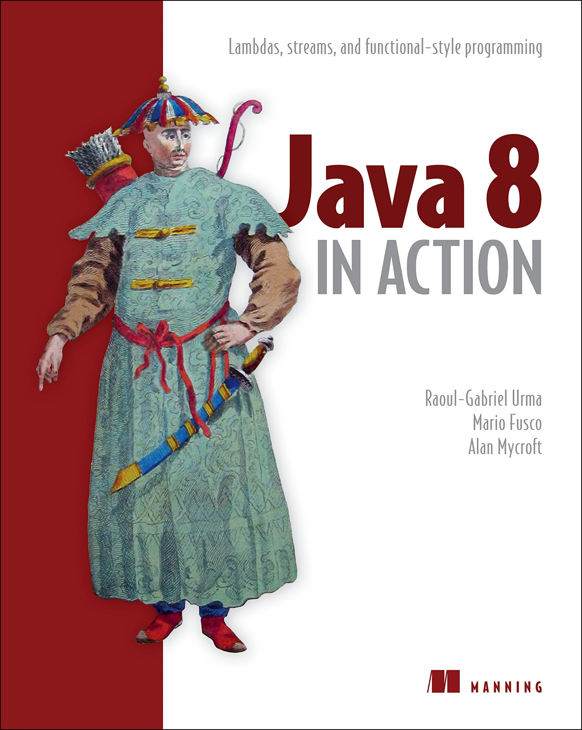
Bibliography
Code samples
https://github.com/java8/Java8InAction
Mario Fusco’s slides
http://www.slideshare.net/mariofusco/presentations

Slide 64
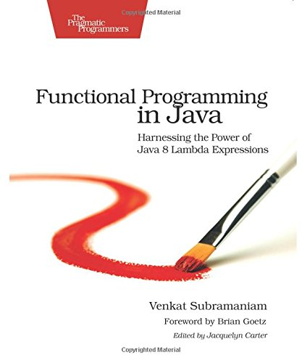
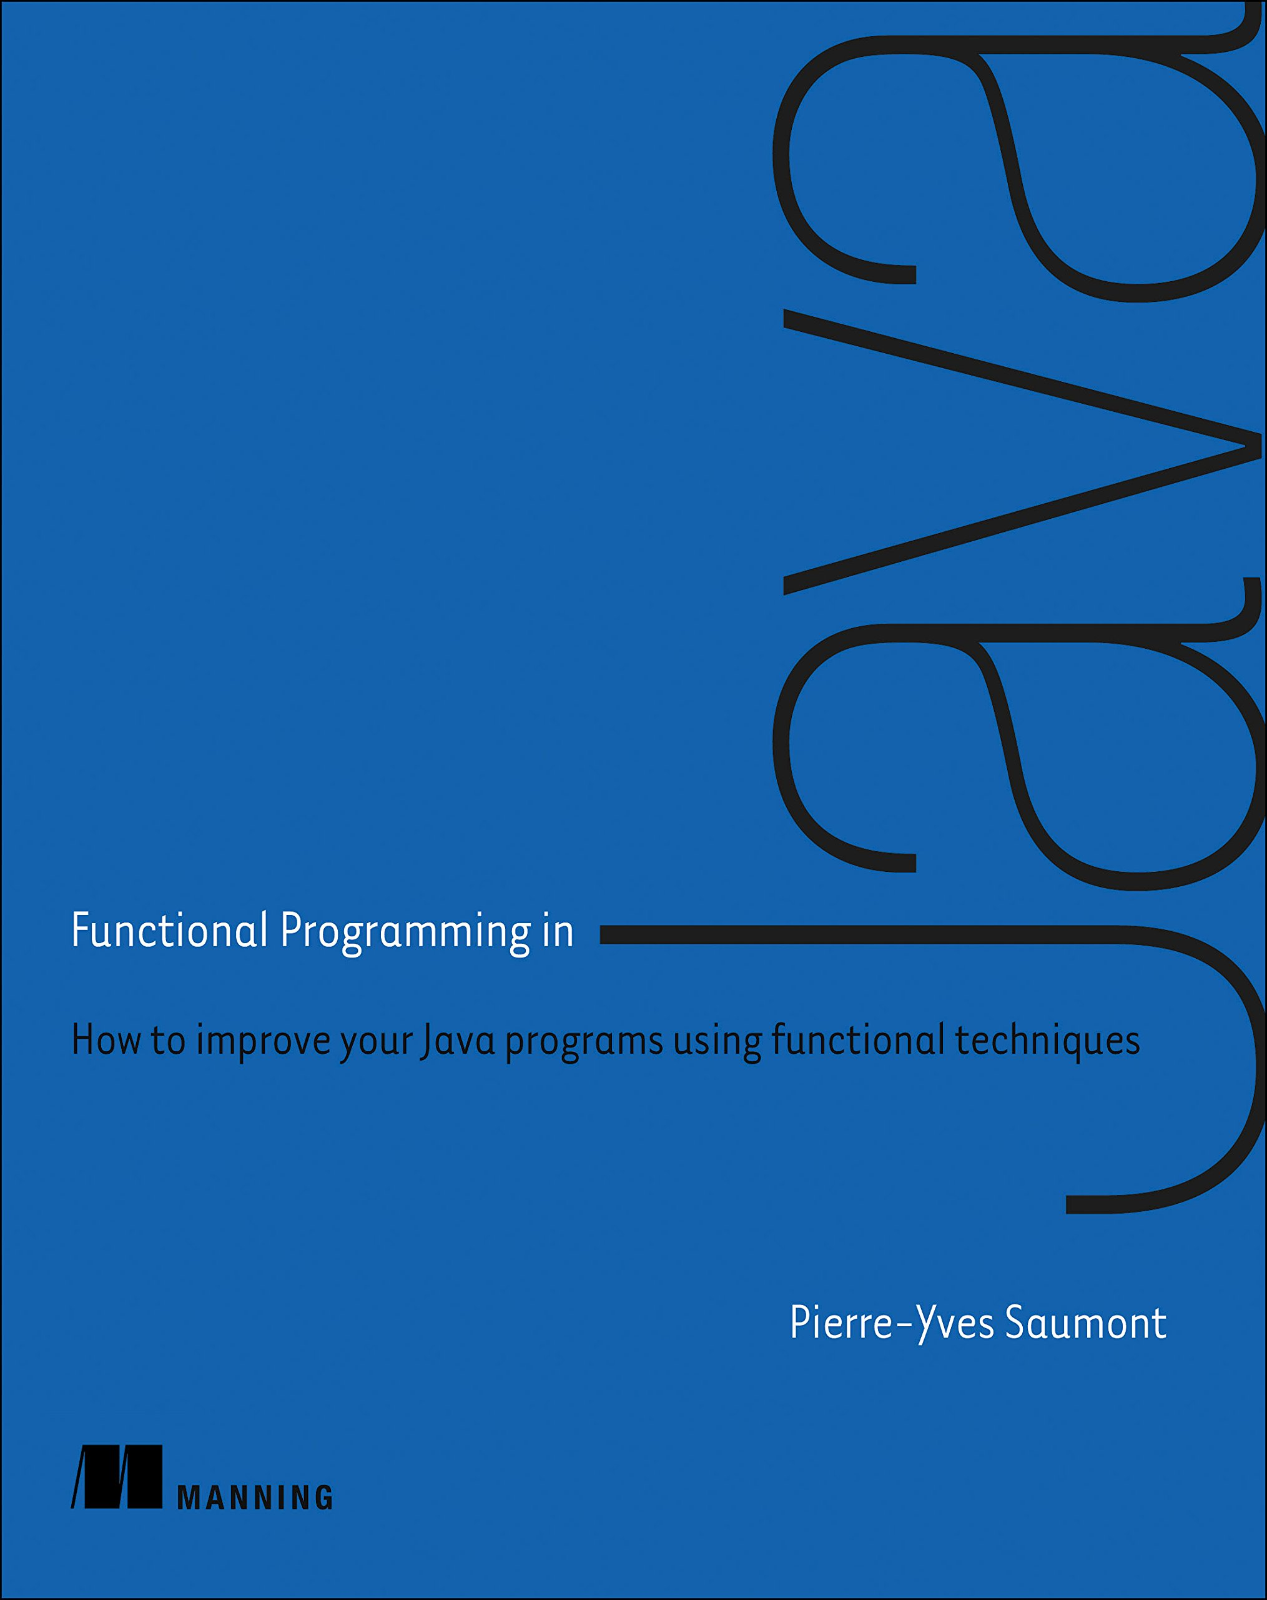
Bibliography

Slide 65
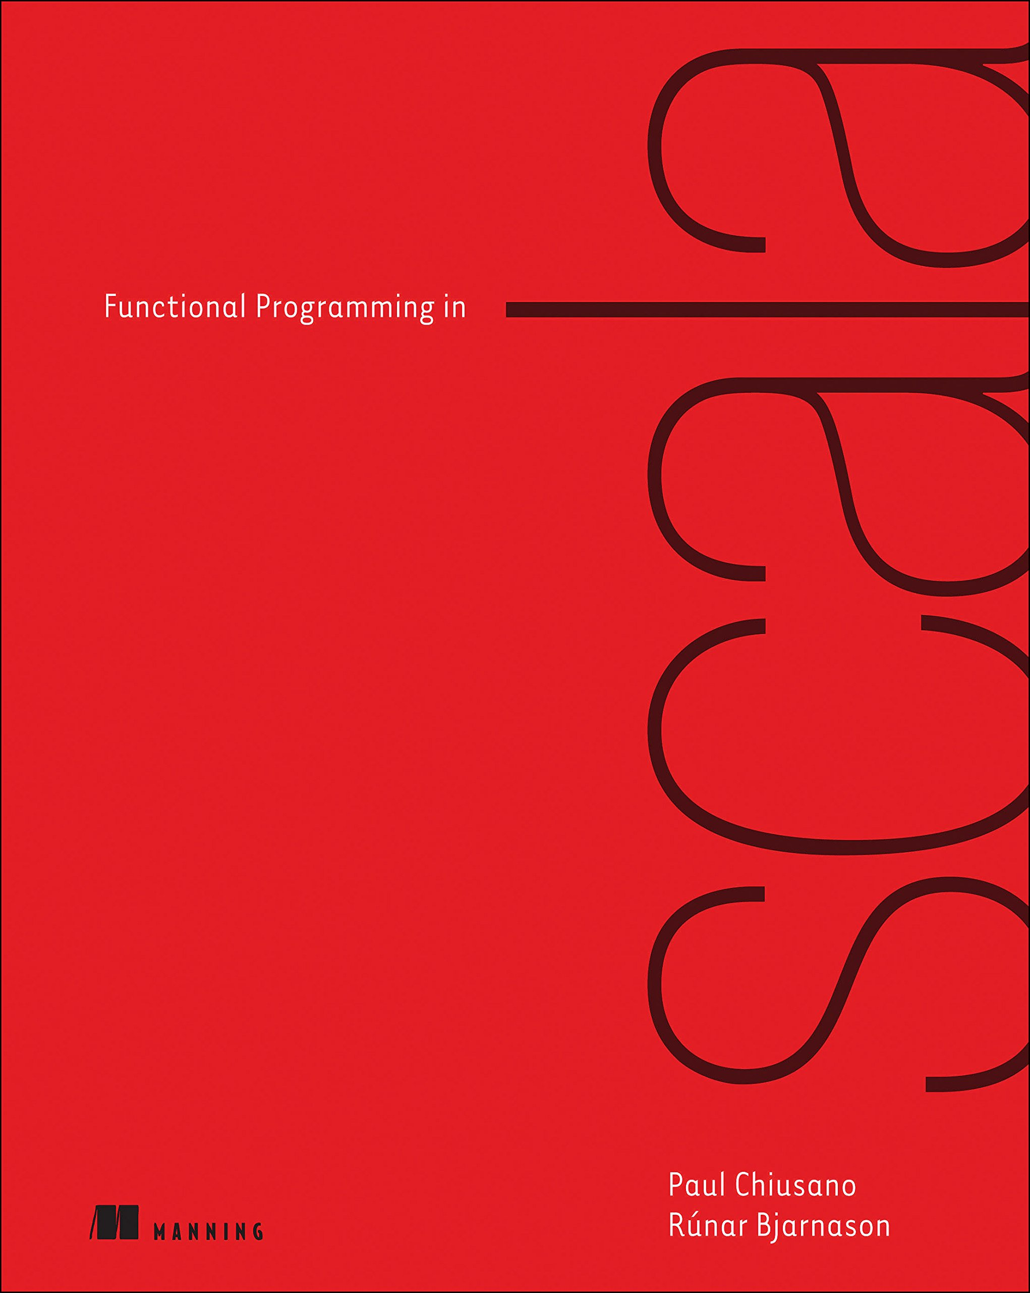
Bibliography

